Slide 1
Spring Fundamentals

Slide 2
Web Servers and Services

Slide 3
What is a Server?
A server is a program on one computer that listens for connections from client programs on other computers
Servers and client programs communicate over the internet with packets of binary data
A server listens for client connections and data at a specific address on the host computer, called a port.
A physical server can have many software servers, each listening on a different port
Only one software server can listen on a given port at a time

Slide 4
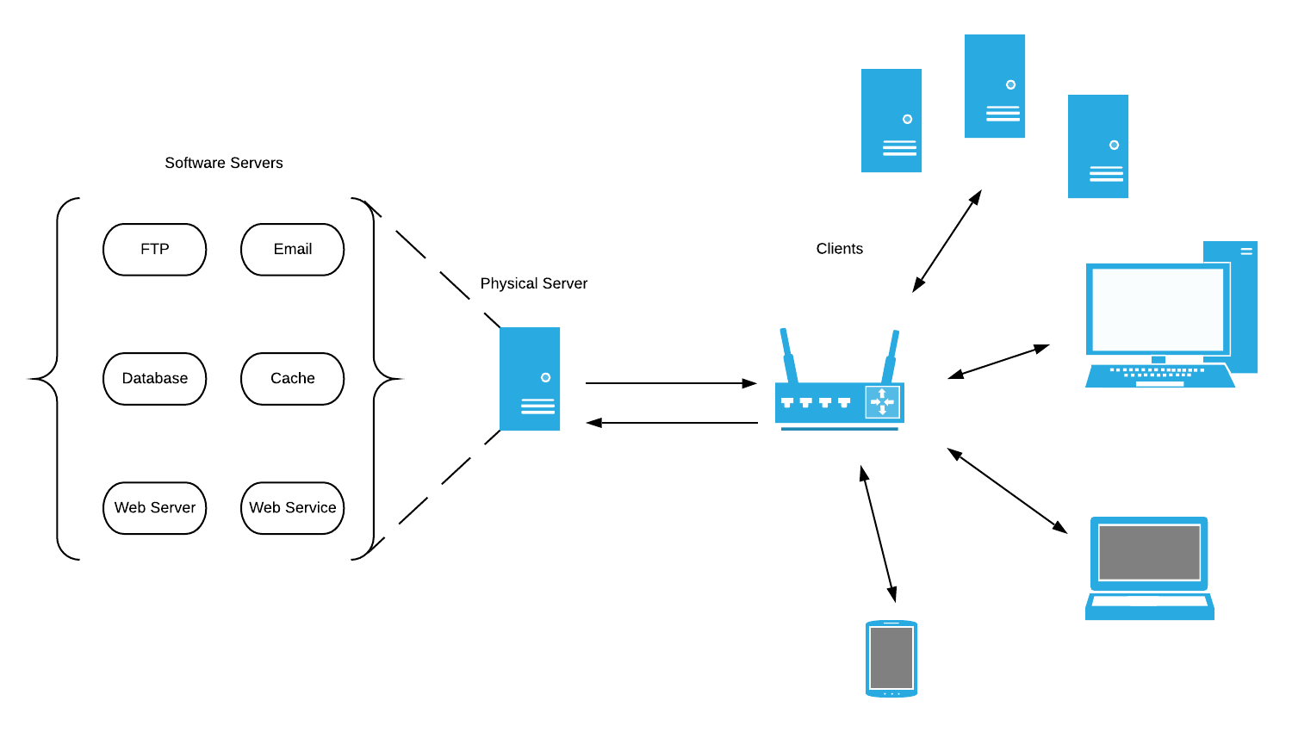
Software and Physical Servers

Slide 5
What is a Web Service
When a server program listens for client connections and data, it expects to receive that data according to some protocol
There are many protocols for specialized tasks, like file transfer (FTP and SFTP), remote shell access (SSH), and email (IMAP and POP)
A web server is a server program that understands HTTP, the HyperText Transfer Protocol
HTTP was originally designed for sharing HTML (HyperText Markup Language) documents
As the web has grown, HTTP and web servers have grown with it

Slide 6
What is a Web Service?
A web service is a web server that exposes an API for clients to programmatically access
Web services are intended to be abstractions for entire business units of code

Slide 7
How do we build them?
(In Java)

Slide 8
Spring Framework

